Slide 1

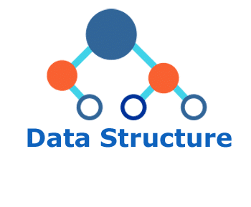
Why Data Structure? Applications of Data Structures
Md. Rafidul Hasan Khan
Lecturer, Dept. of CSE, FSIT
rafidul.cse0401.c@diu.edu.bd

Slide 2
Data Structure (1/3)
Data – leads to fact, figure, quantity etc
e.g. 150, Rahim, Dhaka etc
Data need storage in the memory
Data need to be organized in the memory
Why?
To store the data efficiently (in short time)
To process the data cleverly (in lower storage)
Data Structure helps computing to efficiently store data and process cleverly
DSAH@DS, Week-1
‹#›

Slide 3
Data Structure (2/3)
Data Structure
Foundation of computer science
You must develop strong feeling about data structure applications
Data Structure
Provide efficient arrangement to store data in the memory e.g. Link-List, Stack, Queue, Tree, Graph etc
Each data structure define how to store and manupulate data
DSAH@DS, Week-1
‹#›

Slide 4
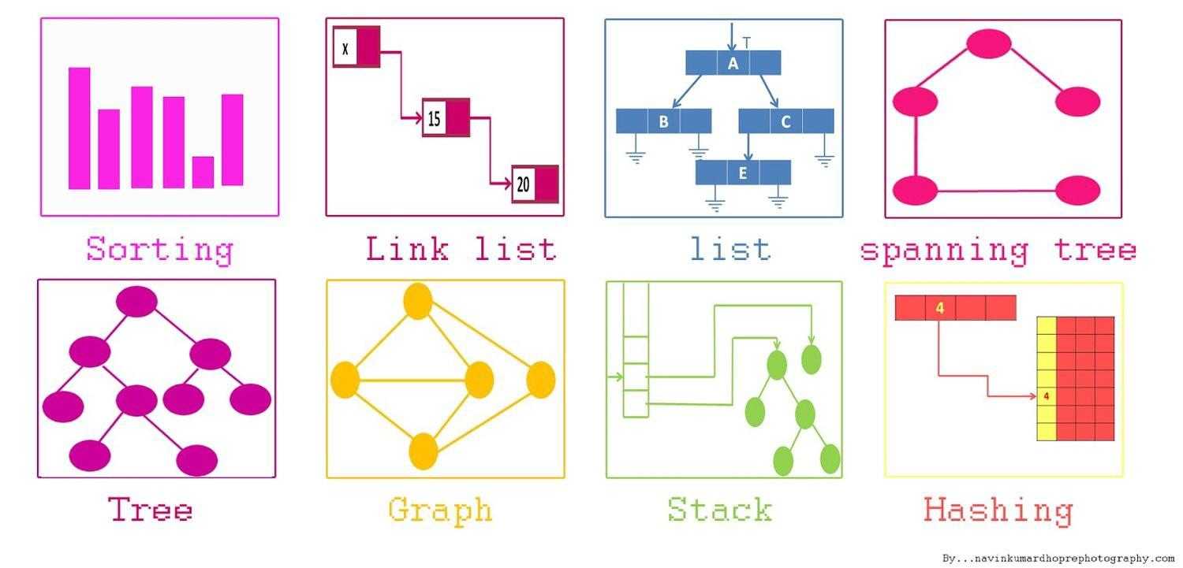
Data Structure (3/3)
Data Structures
Different data strucures are having different applications
DSAH@DS, Week-1
‹#›

Slide 5
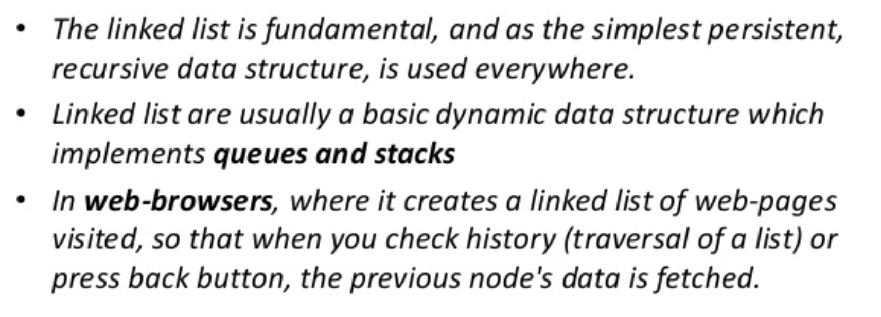
Data Structure Applications
Link-List
DSAH@DS, Week-1
‹#›

Slide 6
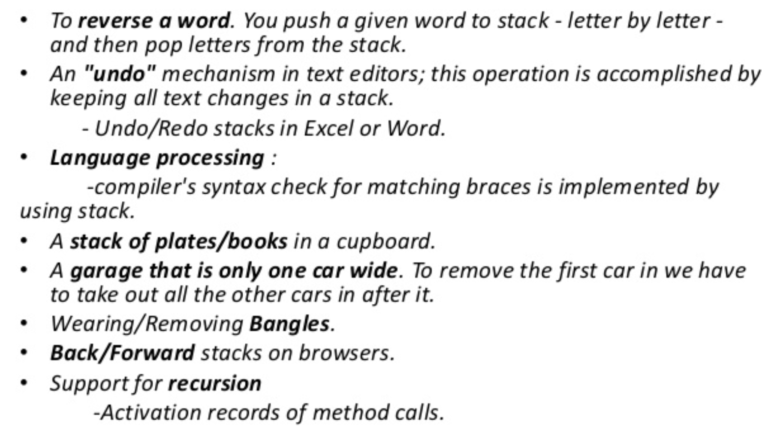
Data Structure Applications
Stack
DSAH@DS, Week-1
‹#›

Slide 7
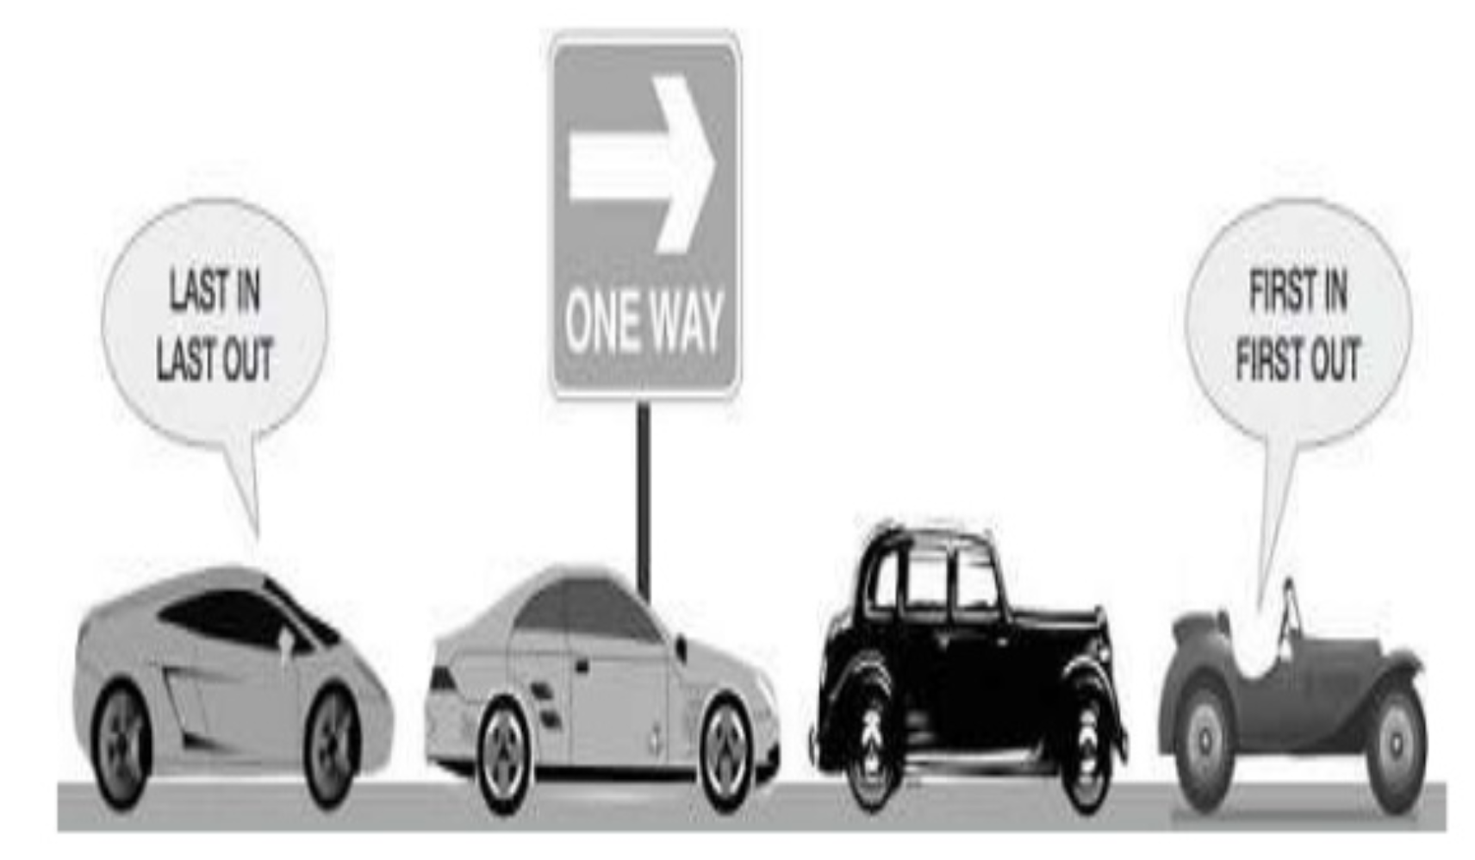
Data Structure Applications
Queue
DSAH@DS, Week-1
‹#›

Slide 8
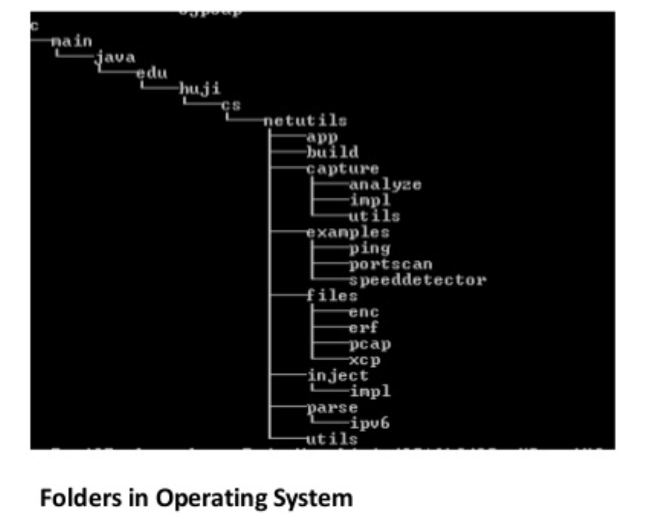
Data Structure Applications
Tree
DSAH@DS, Week-1
‹#›

Slide 9
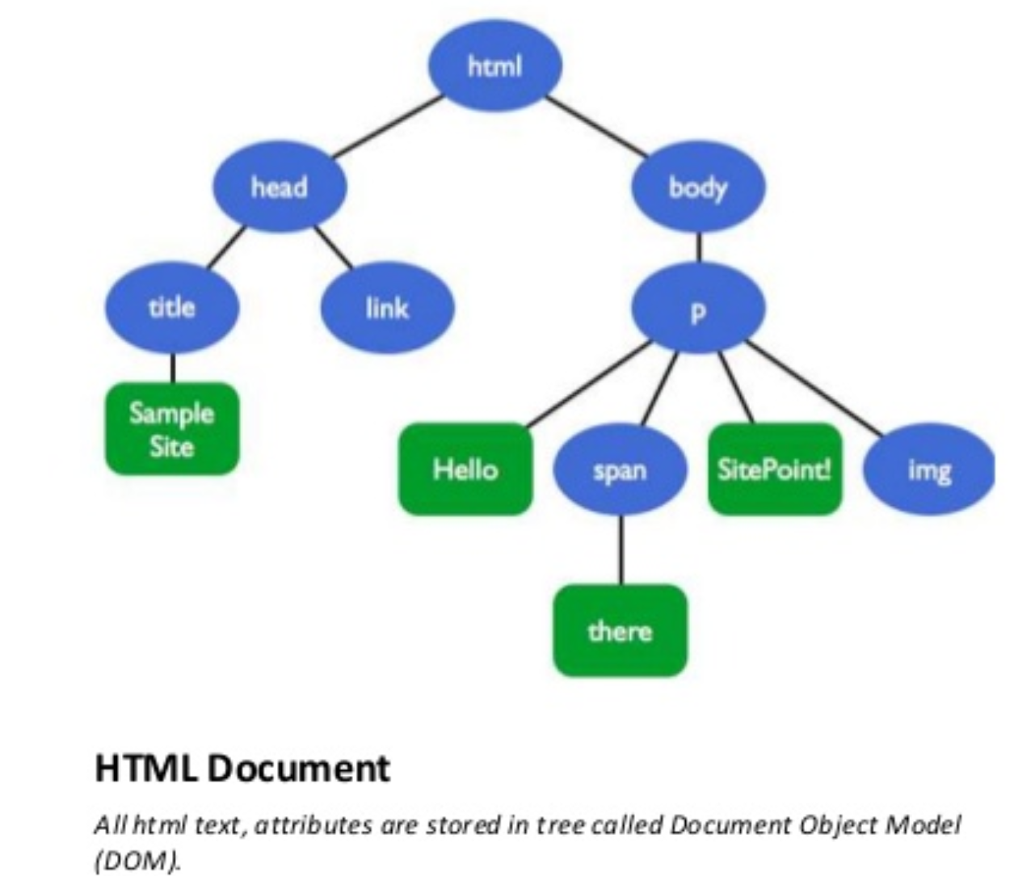
Data Structure Applications
Tree
DSAH@DS, Week-1
‹#›

Slide 10
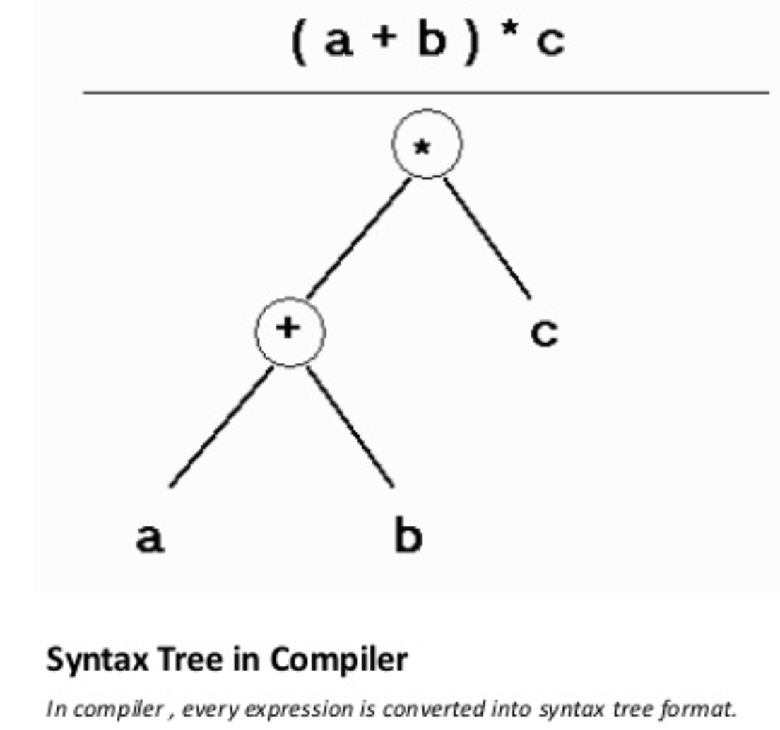
Data Structure Applications
Tree
DSAH@DS, Week-1
‹#›

Slide 11
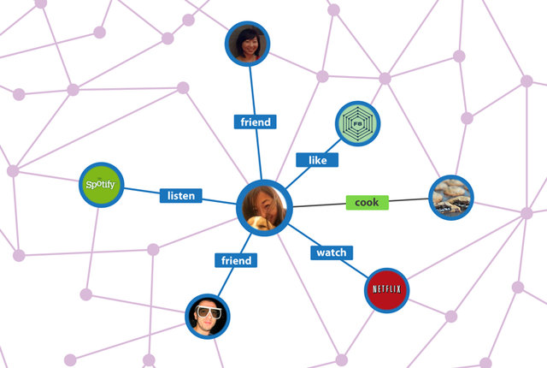
Data Structure Applications
Graph
DSAH@DS, Week-1
‹#›

Slide 12
Summary
Data Structure is a foundation
Core competency is the key to success
Application of data structure is diversive
Heart of Computer Science
DSAH@DS, Week-1
‹#›

